Slide 1
KS1 Parents Phonics Workshop

Slide 2
Why teach phonics?
The ability to read and write well is a vital skill for all children, paving the way for an enjoyable and successful school experience.
Phonics helps children to develop good reading and spelling skills
e.g. cat can be sounded out for reading and spelling
We use a synthetic scheme designed by the Trust incorporating a scheme called ‘Read, Write, Inc.’ by Ruth Miskin and a document called ‘Letters and Sounds’ as our teaching resource. It is consistently used throughout school.

Slide 3
Why synthetic phonics?
“Synthetic phonics offers the vast majority of young children the best and most direct route to becoming skilled readers and writers”
Sir Jim Rose, Rose Review of Reading 2006
Synthetic phonics is simply the ability to convert a letter or letter group into sounds that are then blended together into a word.

Slide 4
So, phonics at a glance is……..
Skills of segmentation and blending
Knowledge of the alphabetic code.

Slide 5
Phonics consists of:
Identifying sounds in spoken words
Recognising the common spellings of each phoneme.
Blending phonemes into words for reading.
Segmenting words into phonemes for spelling.

Slide 6
Some definitions:
A phoneme
This is the smallest unit of sound in a word.
How many phonemes can you hear in cat?

Slide 7
A phoneme you hear
A grapheme you see
These are the letters that represent the phoneme.
Children need to practise recognising the grapheme and saying the phoneme that it represents.

Slide 8
How to say the sounds
Saying the sounds correctly with your child is extremely important
The way we say sound may well be different from when you were at school
We say the shortest form of the sounds

Slide 9
The 44 phonemes
/b/ | /d/ | /f/ | /g/ | /h/ | /j/ | /k/ | /l/ | /m/ | /n/ | /ng/
/p/ | /r/ | /s/ | /t/ | /v/ | /w/ | /y/ | /z/ | /th/ | /th/ | /ch/
/sh/ | /zh/ | /a/ | /e/ | /i/ | /o/ | /u/ | /ae/ | /ee/ | /ie/ | /oe/
/ue/ | /oo/ | /ar/ | /ur/ | /au/ | /er/ | /ow/ | /oi/ | /air/ | /ear/ | /ure/

Slide 10
This is where it gets tricky!
Phonemes are represented by graphemes.
A grapheme can consist of 1, 2 or more letters.
A phoneme can be represented/spelled in more than one way ( cat, kennel, choir)
The same grapheme may represent more than one phoneme ( me, met)

Slide 11
Segmenting
‘Chopping Up’ the word to spell it out
The opposite of blending
Identifying the individual sounds in a spoken word (e.g. h-i-m , s-t-or-k) and writing down letters for each sound (phoneme) to form the word him and stork

Slide 12
Blending
Recognising the letter sounds in a written word, for example:
c-u-p
and merging or ‘blending’ them in the order in which they are written to pronounce the word ‘cup’

Slide 13
Once children are good with single phonemes…
DIGRAPHS – 2 letters that make 1 sound
ll ss zz oa ai
TRIGRAPHS – 3 letters that make 1 sound
igh dge

Slide 14
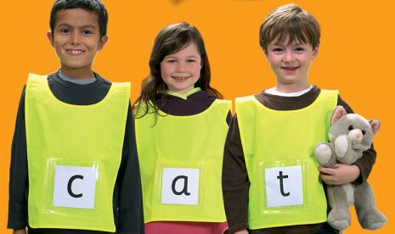
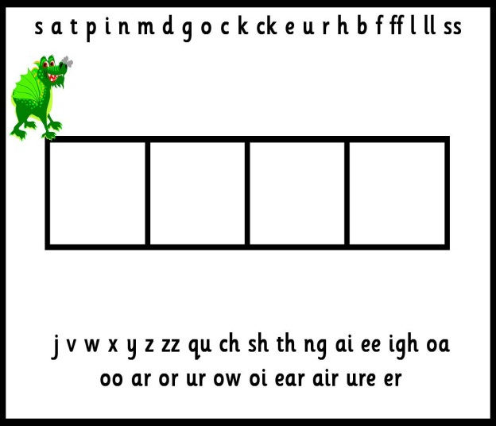
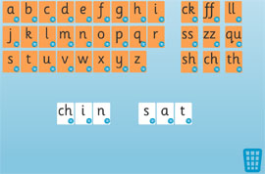
Phonic learning is fun!
The children learn and practise their phonemes in lots of fun ways:
Sound talking and rhyming.
Playing games – table games or interactive games on the computer.
Using phoneme frames, “sound buttons” and whiteboards to spell words.
Sorting phonemes.
Making words with phonemes.
Being phoneme “detectives”.
Reading and writing sentences. Silly sentences are great fun!
Notes:
Sequence in lesson of revisit/revise, teach, practise, apply

Slide 15
How can we help?
Sing an alphabet song together
Play ‘I spy’
Continue to play with magnetic letters, using some two-grapheme (letter) combinations, eg: r-ai-n = rain blending for reading
rain = r-ai-n segmenting for spelling
Praise children for trying out words
Look at tricky words
Look for phonic games
Play pairs with words and pictures

Slide 16
REMEMBER: Phonics is not the only thing needed to become a fluent reader.
Please continue to read with your child each night and encourage them to:
Sound out
Re-read to check it makes sense.
Use pictures for clues.
Ask questions about the book.
And most importantly ENJOY READING!

Slide 17
Enjoy – we want to create readers for life!

